Slide 1
Classical problems of Synchronization with Semaphore Solution

Slide 2
PROCESS SYNCHRONIZATION
Critical Sections
A section of code, common to n cooperating processes, in which the
processes may be accessing common variables.
A Critical Section Environment contains:
Entry Section: Code requesting entry into the critical section.
Critical Section Code in which only one process can execute at any one time.
Exit Section The end of the critical section, releasing or allowing others in.
Remainder Section Rest of the code AFTER the critical section.

Slide 3
Solution to Critical-Section Problem
1. Mutual Exclusion - If process P_{i} is executing in its critical section, then no other processes can be executing in their critical sections
2. Progress - If no process is executing in its critical section and there exist some processes that wish to enter their critical section, then the selection of the processes that will enter the critical section next cannot be postponed indefinitely
3. Bounded Waiting - A bound must exist on the number of times that other processes are allowed to enter their critical sections after a process has made a request to enter its critical section and before that request is granted
Assume that each process executes at a nonzero speed
No assumption concerning relative speed of the n processes

Slide 4
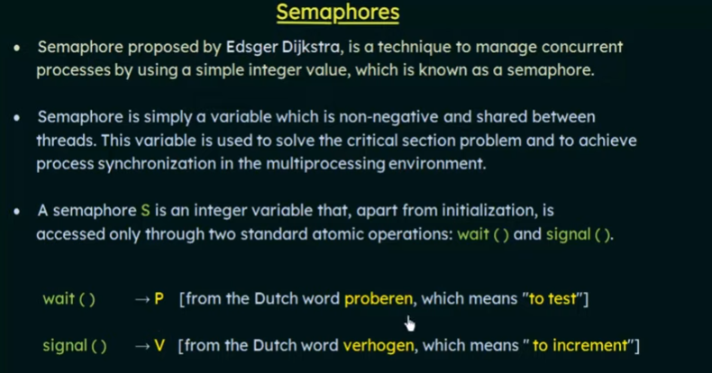

Slide 5
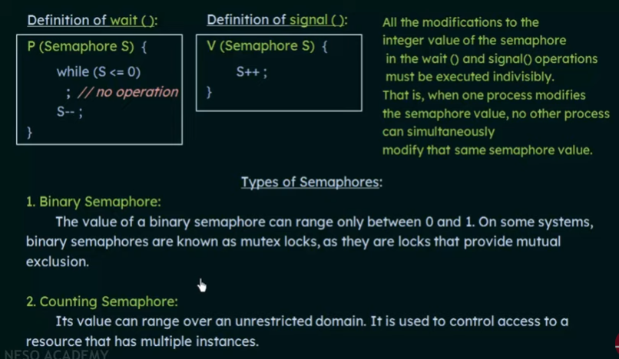

Slide 6
Classical problem of synchronization
1. Bounded-buffer (or Producer-Consumer) Problem,
2. Dining-Philosophers Problem,
3. Readers and Writers Problem,

Slide 7
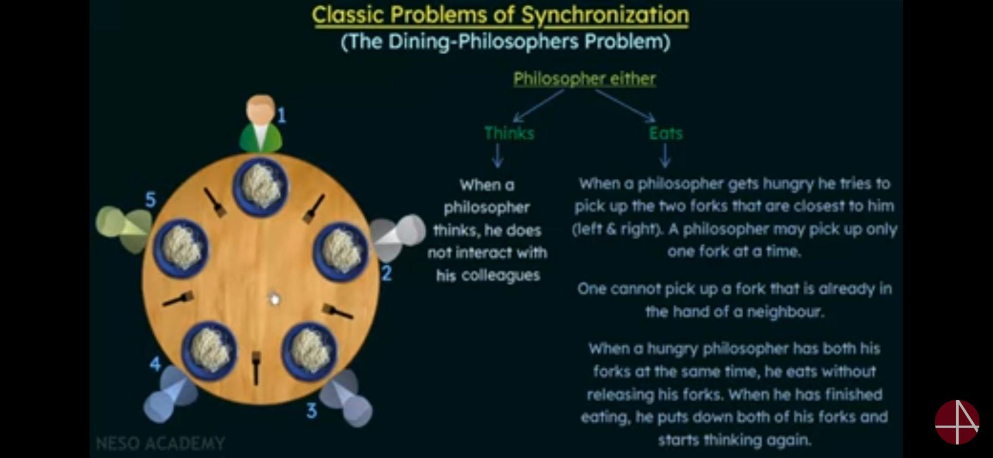
Dining-Philosophers Problem

Slide 8
Solution
One simple solution is to represent each fork/chopstick with a semaphore
A philosopher try to grab a fork /chopstick by executing a wait() operation on that semaphore
He releases his fork /chopsticks by executing the signal() operation on the appropriate semaphores
Thus the shared data are
Semaphore chopstick[5];
Where all the elements of chopsticks are initialized to 1

Slide 9
Dining-Philosophers Problem Algorithm
The structure of Philosopher i:
do {
wait ( chopstick[i] );
wait ( chopStick[ (i + 1) % 5] );
// eat
signal ( chopstick[i] );
signal (chopstick[ (i + 1) % 5] );
// think
} while (TRUE);
What is the problem with this algorithm?

Slide 10
Solutions
Several solutions are possible:
Allow only 4 philosophers to be hungry at a time.
Allow pickup only if both chopsticks are available. ( Done in critical section )
Odd # philosopher always picks up left chopstick 1st, even # philosopher always picks up right chopstick 1st

Slide 11
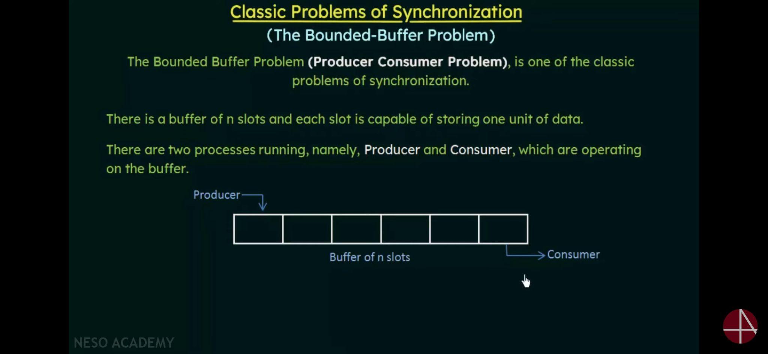

Slide 12
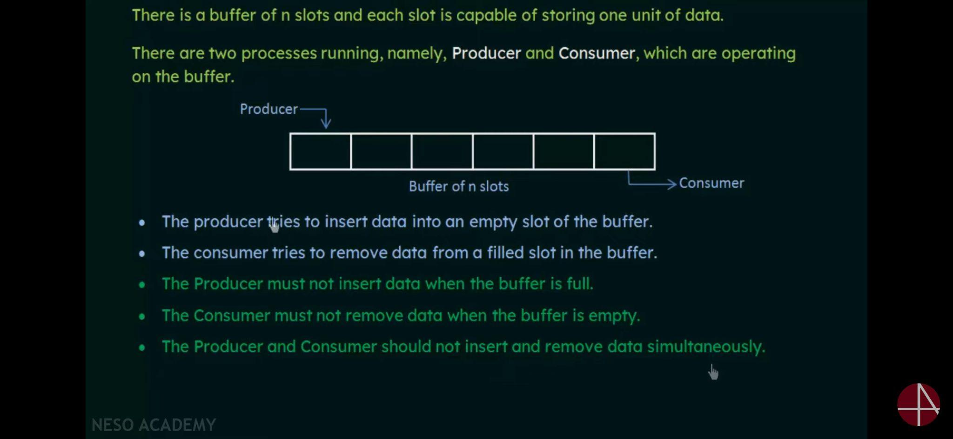

Slide 13
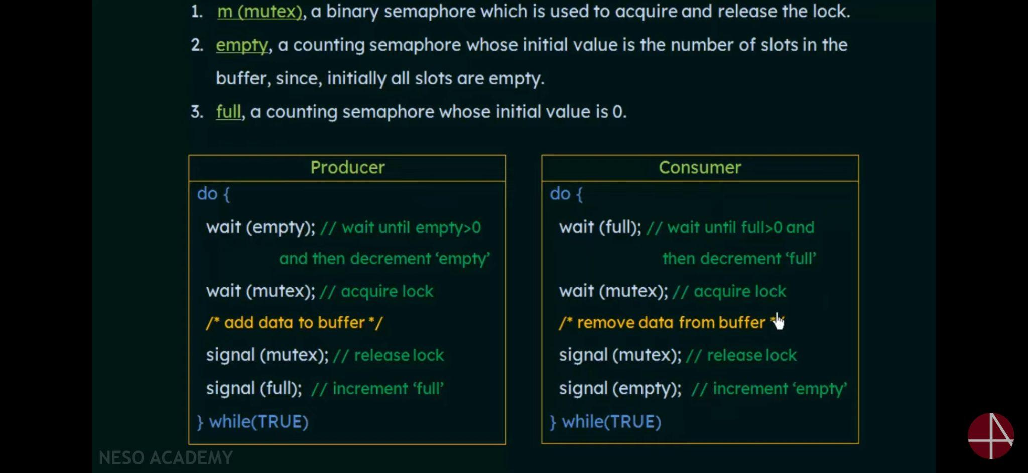

Slide 14
Readers-Writers Problem
A data set is shared among a number of concurrent processes
Readers – only read the data set; they do not perform any updates
Writers – can both read and write
Problem – allow multiple readers to read at the same time
Only one single writer can access the shared data at the same time
Several variations of how readers and writers are treated – all involve priorities
Shared Data
Data set
Semaphore mutex initialized to 1
Semaphore wrt initialized to 1
Integer readcount initialized to 0

Slide 15
Readers-Writers Problem
Problem parameters:
One set of data is shared among a number of processes
Once a writer is ready, it performs its write. Only one writer may write at a time
If a process is writing, no other process can read it
If at least one reader is reading, no other process can write
Readers may not write and only read

Slide 16
Solution when Reader has the Priority over Writer
Here priority means, no reader should wait if the share is currently opened for reading.
Three variables are used: mutex, wrt, readcnt to implement solution
semaphore mutex, wrt; // semaphore mutex is used to ensure mutual exclusion when readcnt is updated i.e. when any reader enters or exit from the critical section and semaphore wrt is used by both readers and writers
int readcnt; // readcnt tells the number of processes performing read in the critical section, initially 0

Slide 17
Readers-Writers Problem (Cont.)
The structure of a writer process
do {
wait (wrt) ;
// writing is performed
signal (wrt) ;
} while (TRUE);

Slide 18
Readers-Writers Problem (Cont.)
The structure of a reader process
do {
wait (mutex) ;
readcount ++ ;
if (readcount == 1)
wait (wrt) ;
signal (mutex)
// reading is performed
wait (mutex) ;
readcount - - ;
if (readcount == 0)
signal (wrt) ;
signal (mutex) ;
} while (TRUE);

Slide 19
